Slide 1
The Eye of a Skilled Software Tester
Rikard Edgren
TIBCO Spotfire
Scandinavian Developer Conference 2011-04-05
Notes:
In the Conversation Corner they are discussing if agile teams need dedicated tester.
I can’t be there, I haven’t finalized my ”being at two places simultaneously” abilities.
But I would say that any ambitious software development team needs skilled, manual software testers that can find defects and information that machines can't give us.
It would be good for me to know which roles you in the audience belong to (so I know who I can offend...)
Testers, developers, project managers, managers, others?

Slide 2
The Test Eye
want to see problems
see a lot of things
look at many places
look often
focus on what’s important
look for others
Notes:
The tester self is the most important tool for skilled testing.
I found it fruitful to focus on the eye, a lot of important aspects appeared.
Not a complete list, but almost ;)

Slide 3
Want to See Problems
motivation
we want working software, but...
…enjoy finding problems before customers
Notes:
Motivation is a key aspect for a lot of activities.
A bored tester that just want the day to end, won’t do a good job.
A motivated tester that is happy when he finds a bug, has a better chance.
That problems make it more difficult to finalize our tasks, is not a factor.
I once sat next to a tester prospect who simply didn’t see problems when they happened.
When asked about it, there were excuses on behalf of the developer, e.g. ”well, you know, that’s difficult”,
and when saying ”but if this happens when someone is doing this other thing, the conclusion might be devastating”,
the answer was ”but will that really happen?”
This brain-turnover (wanting to not be done) can be difficult to do for developers.
I think it is the main reason for the ”programmers shouldn’t test their own code” statement.

Slide 4
See a Lot of Things
ready for the unexpected (serendipity)
prepare environment (Error-Prone Machine)
see more than bugs (low-hanging fruit)
Notes:
Software is complex, and even more is software testing.
We don’t know what we need to know, therefore we need to be prepared to notice things we weren’t looking for, when looking for what we thought were important.
Testing is oozing with serendipity.
Control your environment, make interesting setups (also on personal machine), and you can see interesting stuff almost without extra cost
http://thetesteye.com/blog/2008/04/an-error-prone-windows-machine/
http://thetesteye.com/blog/2008/05/bcm-basic-configuration-matrix/
You can look for anything, but I especially recommend to try to create low-hanging fruit for developers; bugs and enhancement that with low cost will improve the software.

Slide 5
Look at Many Places
Screen, files, logs, docs, temp files, marketing...
Look at more sources than specifications
- business usage
- technology
- environments
- taxonomies
- bug history/support incidents
- standards
- test analysis heuristics
- quality characteristics
Notes:
Many places, e.g. do you know what all deliverables are?
Do you double-check problems in several places, if applicable?
Look at Rob Sabourin’s excellent 10 Sources for Testing Ideas:
http://www.amibugshare.com/articles/Article_10_Sources_of_Testing_Ideas.pdf
and upcoming stuff at thetesteye.com.

Slide 6
Ongoing Test Ideas
can evaluate Capability, Reliability, Usability, Charisma, Security, Performance, Installability, Compatibility et.al.
in the back of your head
executed for free
reveals more information the more you test
http://thetesteye.com/posters/TheTestEye_SoftwareQualityCharacteristics.pdf
Notes:
things you have in the back of your head all the time
Characteristics (e.g. Stability, Performance) that are executed for free all the time
http://thetesteye.com/posters/TheTestEye_SoftwareQualityCharacteristics.pdf

Slide 7
Look Often
practice and learn in your optimal way
think, read, discuss, repeat
all days are testing days
Notes:
Everyone learn best in their own way.
My own boom in software testing learning came by discussing our testing problems at every lunch for a couple of years.
You can learn a lot from other activities, especially anything mind-engaging (like playing with children...)

Slide 8
Focus on What’s Important
the most difficult thing...
requirements and knowledge about usage helps...
curiosity, collaboration, and active learning of diverse areas helps...
...a skill that evolves over time
Notes:
The really good tester doesn’t just find a lot of bugs, fast.
If you understand the product and the customer needs you will have the ability to find bugs that matter, you will find the bugs that the project want to fix.
This skill evolves over time, but is speeded by curiosity, collaboration, and active learning of diverse areas.
You will not master this by yourself, that’s why a diverse team is good.

Slide 9
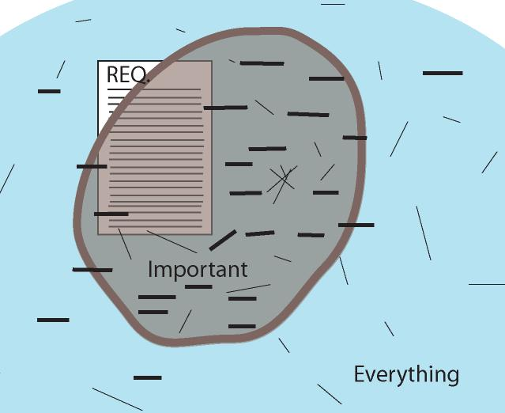
Notes:
The software potato:
The square symbolizes the features and bugs you will find with test cases stemming from requirements (that can’t and shouldn’t be complete)
The blue area is every possible usage, including things that maybe no customers would consider a problem.
The brown area is what is important, there lies those bugs you’d want to find and fix.
So how do you go from the requirements to ”what is important”?
You won’t have time to create test scripts for ”everything”.
So maybe you do exploratory testing (thin lines in many directions), and hope for the best.
Or maybe you test around one-liners (thicker vertical lines), that are more distinct, that are reviewed, and have a better chance of finding the important things.
Either option, some part of luck, and a large portion of hard work is needed.
But I think you have a much better chance if you are using one-liners, especially if it’s a larger project.
Lately I have realized that one-liners aren’t essential; that this problem has been solved many times at many places with many different approaches. What is common could be that testers learn a lot of things from many different sources, combine things, look at many places, think critically and design tests (in advance or on-the-fly) that will cover the important areas.
Recently I realized there can be more than one potato, there might be small potatoes that are the best of them’all…

Slide 10
The Eye for Others
system testers have system knowledge
“one of few who will examine the full product in detail”
Do you know what you should know?
Who are “The Others”?
PI = Product Investigator
Notes:
“one of few who will examine the full product in detail” – Cem Kaner, Testing Computer Software, 2nd Edition.
Fascinating and productive dynamics between details and the whole.

Slide 11
Agile Testing Quadrant
originating from Brian Marick
Notes:
Are you familiar with the Agile Testing Quadrant?
Manual system testing usually happens in the upper part, especially the right corner; evaluating the product, facing the business.

Slide 12
Agile Testing Quadrant
originating from Brian Marick
Notes:
However, I believe skilled software testing overlaps with all other corners.
We have talked about some Ilities, we can help with unit tests, and we can support the team by acting as a customer.
We are also testing outside the quadrant, looking for things we don’t know if they are important (again enabling serendipity.)

Slide 13
Automated vs. Manual
some should be automated
some should be tested subjectively
many should be tested with both approaches
complementary, not antagonistic
Who? What? When?
It depends...
Notes:
Some, but not all, of these tests can be quantified and made regressionable as automated tests.
Some are better tested manually and subjectively (end users will surely be subjective.)
For most, both automated and manual approaches are recommended, because repetitive automated tests and changing manual tests are complementary, not antagonistic.
Computers are faster, humans are better judges of importance.
A perfect scenario could be where developers create automated tests for the ”checking”, and system testers can use diverse approaches to do the necessary testing (without being bothered by ”easy” bugs.)
If you’re doing regression testing, automation is closer. When testing something new, manual is a better fit. Tools can always be used!

Slide 14
Creativity
where would you like to have an extra pair of eyes?
Notes:
Adults first answer: ”in the back of my head”
Children say things like: ”in my big sisters’ room”
”in the future”?
Or the best answer: “I would give it to someone blind.”
“At the dawn”
“With God”

Slide 15
Creativity
where should a tester like to have an extra pair of eyes?
Notes:
Where should a tester like to have an extra pair of eyes?
* in the developer’s room
* inside the executed code
* alongside the end user’s
* at a future support desk
You know, all of these can be arranged...

Slide 16
Closing Notes
system testing is more craft than engineering
software is made for humans, by humans
open your eyes
Notes:
I would like it to be art, but it isn’t.
Be aware that what you see is not what others see.

Slide 17
Questions ???
background image: Miska Knapek
www.thetesteye.com
redgren@tibco.com

